Slide 1

RECOVERY OFFICE
Public Assistance Applicant Briefing
FEMA-4528-DR-MS, COVID-19
Declared: April 5, 2020
Incident Period: Jan 20, 2020 - Continuing

Slide 2
Clayton French
State Public Assistance Officer
Public Assistance Definition
Applicant
Category of Work
Project Development
Common Questions

Slide 3
Public Assistance Defined
Supplemental financial assistance to State and local governments and certain private non-profit organizations for response and recovery activities required as a result of a federally declared disaster.
Funding is cost shared at a federal share of no less than 75% of eligible costs.

Slide 4
Public Assistance Defined
It is a supplemental cost REIMBURSEMENT program with specific eligibility requirements.
The FEMA share of eligible costs will be awarded to the recipient (State) for disbursement to the applicants.

Slide 5
Eligibility Pyramid
COST
WORK
FACILITY
APPLICANT

Slide 6
Eligible Applicants
State
Declared Counties
City / Town / Village within Declared Counties
Other political subdivision of the State
Native American Tribal Governments and Tribal Organizations
Certain Private Non-Profit (PNP) Organizations

Slide 7
Eligible Applicants
  To be an eligible PNP Applicant, the PNP must show that is has:
  A current ruling letter from the IRS granting tax exemption under 501(c/d/e) or Internal Revenue Code of 1954 or
  Documentation from MS Secretary of State substantiating it is a non-revenue producing nonprofit entity doing business under the State Law.

Slide 8
Category of Work – Emergency Protective Measures
FEMA is authorized to provide Public Assistance funding for Emergency Work (Emergency Protective Measures).
Emergency Work is that which must be done immediately to:
Save lives
Protect public health and safety
Protect improved property
Eliminate or lessen an immediate threat of additional damage.

Slide 9

Category of Work – Emergency Protective Measures
FEMA may provide assistance for emergency protective measures including, but not limited to, the following slides, if not funded by the US Dept of Health and Human Services, Centers for Disease Control and Prevention, or other federal agencies:

Slide 10
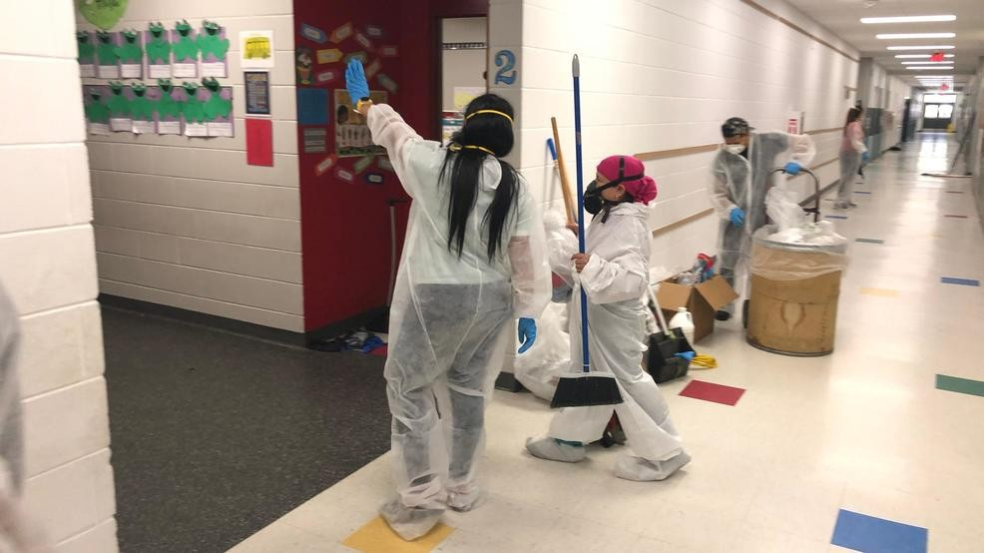
Management, Control and Reduction of the Immediate Threats to Public Health and Safety
Training specific to the declared event.
Disinfection of eligible public facilities.
Technical assistance to state, tribal, or local governments on emergency management and control of immediate threats to public health and safety.

Slide 11
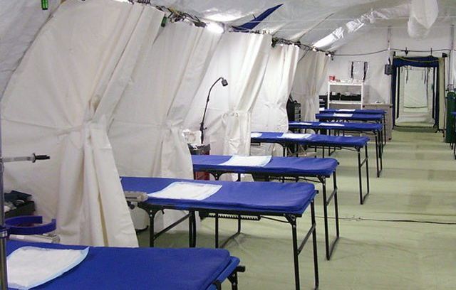
Emergency Medical Care
Non-deferrable medical treatment of infected persons in a shelter or temporary medical facility.
Related medical facility services and supplies.
Temporary medical facilities and/or enhanced medical/hospital capacity (for treatment when existing facilities are reasonably forecasted to become overloaded in the near term and cannot accommodate the patient load or to quarantine potentially infected persons).
(continued next page)

Slide 12

Emergency Medical Care
Use of specialized medical equipment.
Medical waste disposal.
Emergency medical transport.

Slide 13
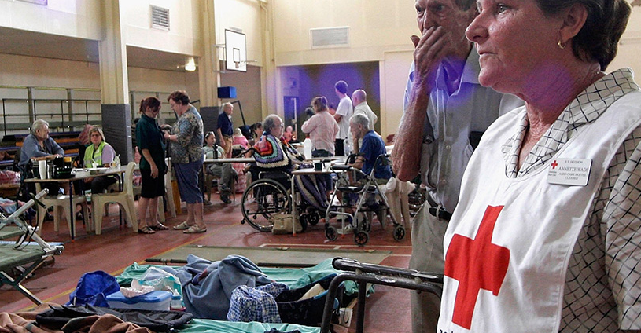
Emergency Medical Sheltering
All sheltering must be conducted in accordance with standards and/or guidance approved by HHS/CDC and must be implemented in a manner that incorporates social distancing measures.
Non-congregate medical sheltering is subject to prior approval by FEMA and is limited to that which is reasonable and necessary.

Slide 14

Emergency Protective Measures continued
Household pet sheltering and containment actions related to household pets in accordance with CDC guidelines.
Purchase and distribution of food, water, ice, medicine, and other consumable supplies, to include PPE and HazMat suits.
Security and law enforcement.

Slide 15
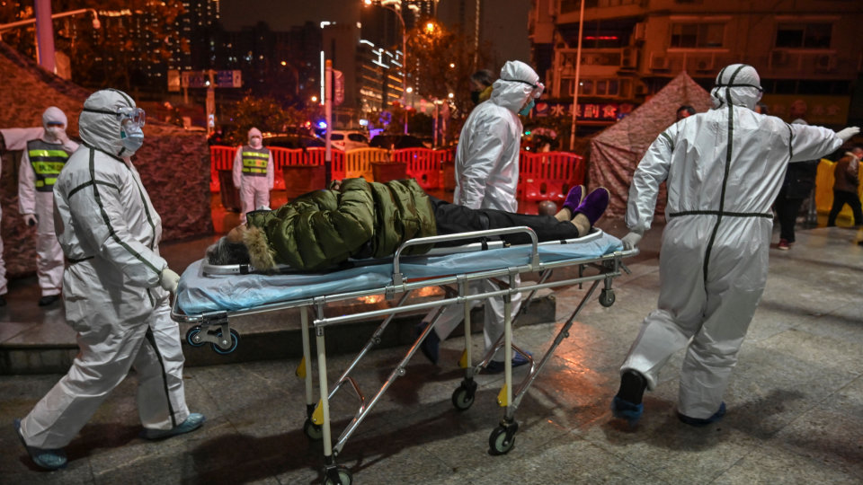
Emergency Protective Measures continued
Communications of general health and safety information to the public.
Search and rescue to locate and recover members of the population requiring assistance.
Reimbursement for overtime when an applicant uses their own labor force for eligible work. Some restrictions apply.

Slide 16

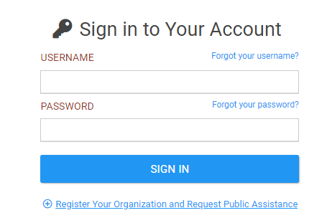
Project Worksheet Development
FEMA will develop Projects based upon submittal of a completed “COVID-19 Project Worksheet” via the Grants Portal. FEMA will not accept paper copies. The “COVID-19 Project Worksheet” is currently in development and will be distributed when available.
The COVID-19 Project Worksheet template is specifically designed to assist Applicants with submission of needed documentation.

Slide 17

Project Worksheet Development
Information Required for the Worksheet:
A description of the activities including when, where, and who conducted the activities.
A summary of how much the activities cost.
Supporting documentation or certification of certain conditions including compliance with applicable federal, State, tribal, territorial, and local laws and regulations pertaining to insurance, contracts, and environmental and historic preservation.

Slide 18

Category Z – Management Cost
Every Applicant can claim costs for managing their grant under 1 Category Z project.
The single Category Z project will be capped at no more than 5% of the final eligible cost of the Emergency Protective Measures projects.
No documentation is required to write the project.
HOWEVER, SUPPORTING DOCUMENTATION WILL BE REQUIRED AT PROJECT CLOSEOUT.

Slide 19
Common Questions for Cat B – COVID 19
“Is the sanitizing/disinfecting of facilities because of COVID 19 eligible?”
For eligible public and PNP facilities, costs associated with disinfecting the facility to eliminate or lessen an immediate threat to lives, public health, and safety ARE eligible. The work should be consistent with current public health guidance as it relates to disinfection recommendations. CDC guidance for disinfection is available at:
www.cdc.gov/coronavirus/2019-ncov/community/organizations/cleaning-disinfection.html.
www.cdc.gov/coronavirus/2019-ncov/infection-control/control-recommendations.html.

Slide 20
Common Questions for Cat B – COVID 19
“Is the purchase of laptops for our county/city employees to allow them to work from home an eligible cost?”
The purchase of computers, laptops, internet service, and other related expenses is NOT eligible as an emergency protective measure. These purchases would be considered increased operating costs which are not eligible for public entities unless the additional costs is specifically related to eligible emergency actions to save lives or protect public health and safety or improved property.

Slide 21
Common Questions for Cat B – COVID 19
“What procurement guidelines must I follow for reimbursement?”
The latest guidelines for purchasing are –
Procurement Under Grants Conducted Under Emergency or Exigent Circumstances for COVID-19 Memo.
https://www.fema.gov/media-library-data/1584457999950-7186ffa29ace3e6faf2ca2f764357013/Procurement_Under_EE_Circumstances_Memo_final_508AB.pdf
COVID-19 Guidance Fact Sheet: Procurements Under Grants During Periods of Exigent or Emergency Circumstances.
https://www.fema.gov/media-library-data/1584386517416-40bc24e5a2c4154c1ee44ed143e6491b/Procurement_During_EE_Circumstances_Fact_Sheet_508AB.pdf

Slide 22
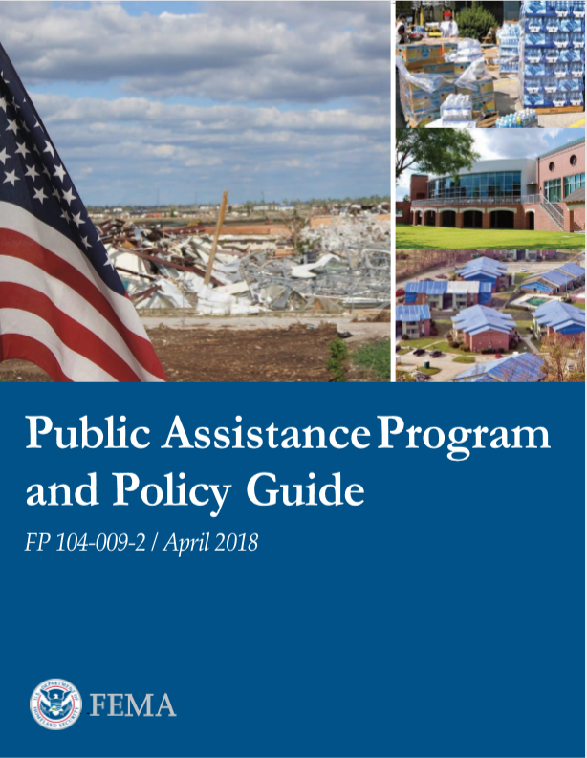
Common Questions for Cat B – COVID 19
“What other resources are there about Category B expenses?”
The Public Assistance Program and Policy Guide
address typical Category B projects and costs.
https://www.fema.gov/media-library/assets/documents/111781
The COVID-19 Eligible Emergency Protective Measures
Fact Sheet
https://www.fema.gov/news-release/2020/03/19/coronavirus-covid-19-pandemic-eligible-emergency-protective-measures

Slide 23
Clayton French
State Public Assistance Officer
Public Assistance Definition
Applicant
Category of Work
Project Development
Common Questions

Slide 24
RECOVERY OFFICE
Public Assistance Applicant Briefing
FEMA-4528-DR-MS, COVID-19
Declared: April 5, 2020
Incident Period: Jan 20, 2020 - Continuing

