Slide 1
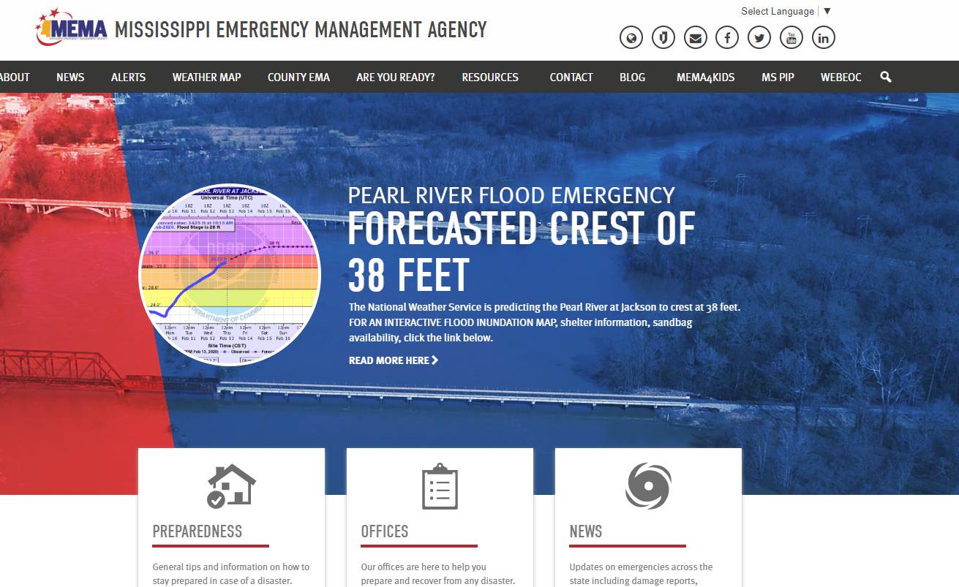
CLICK on “READ MORE HERE”

Slide 2
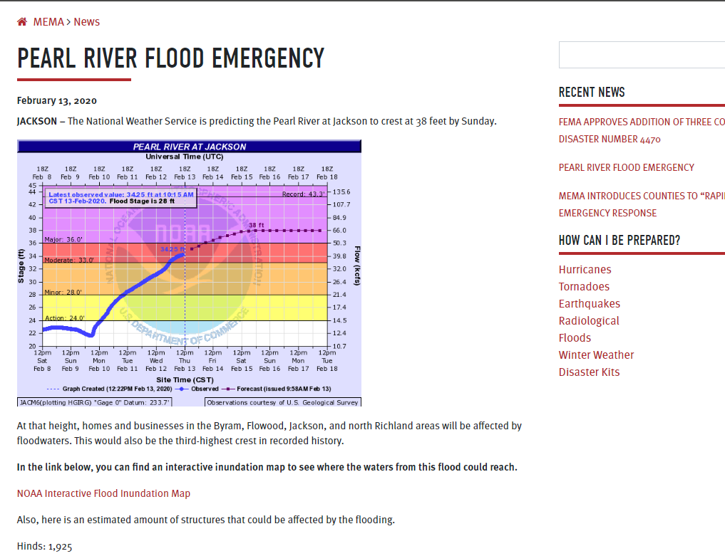
CLICK on “NOAA Interactive Flood Inundation Map”

Slide 3
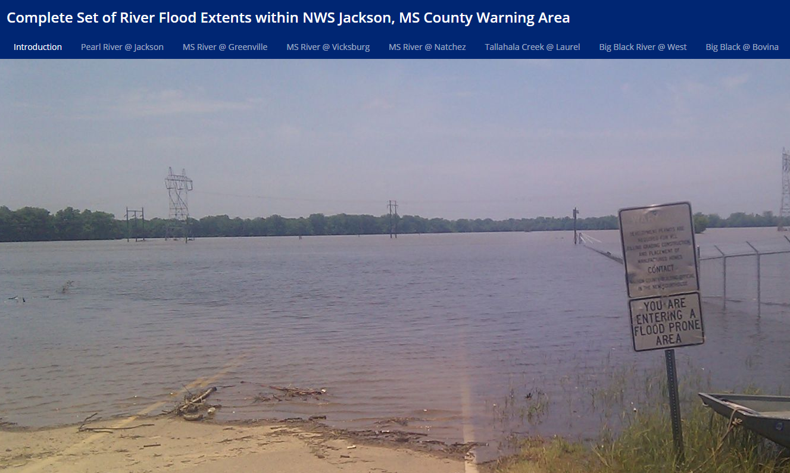
Click on “Pearl River @ Jackson

Slide 4
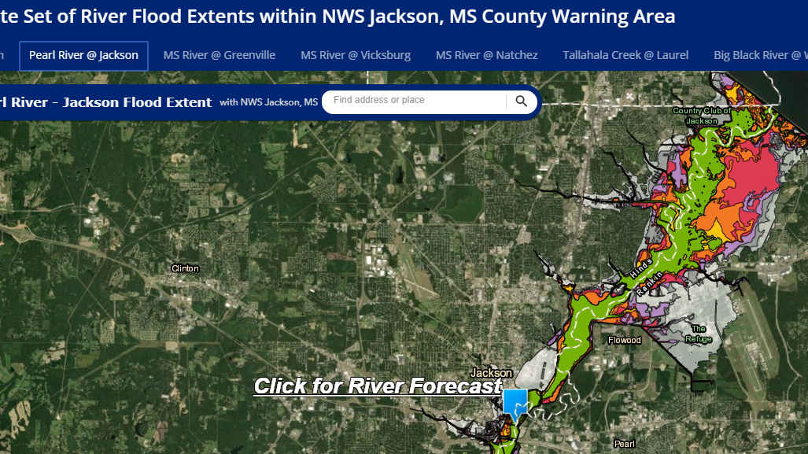
Enter your Address

Slide 5
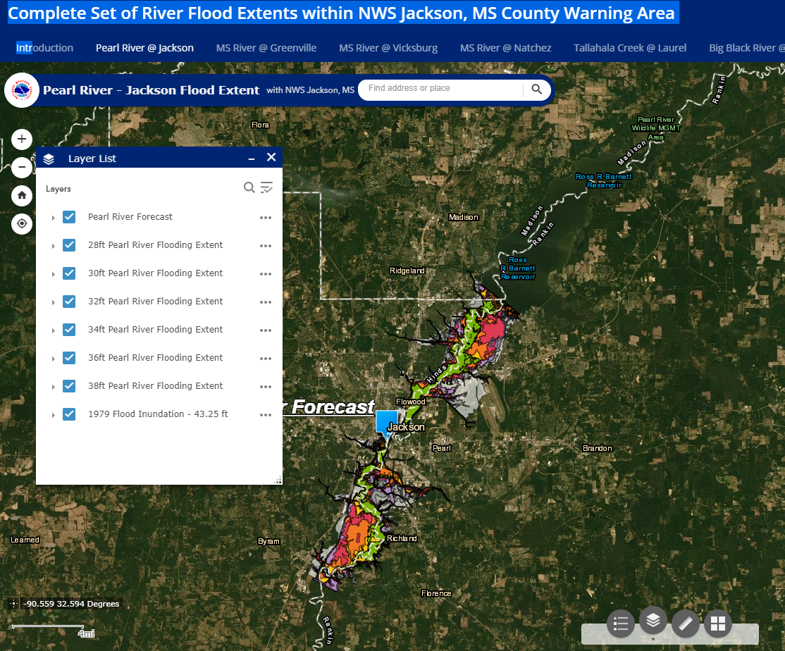
Still need assistance?
Contact:
Hinds County Emergency Operations Center: 601-960-1476
Rankin County Emergency Operations Center: 601-825-1499
1
Click on this layer toggle
2
Select Flood Level On/Off as needed

